Slide 1

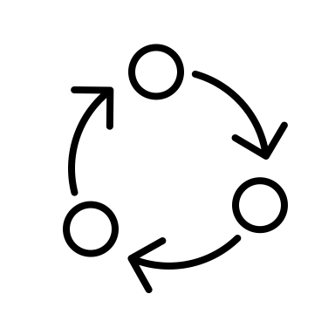
RMI
Source
Code
RMI
Source
Code
Apply
L10n
Dir1
File1
Dir1_1
File1_1
Dir2
File2
Dir1
File1
en/File1_en_US
zh/File1_zh_CN
Dir1_1
File1_1
en/File1_1_en_US
zh/File1_1_zh_CN
Dir2
File2
Locales JSON Dir
ja/html_strings_ja_JP.json
en/html_strings_en_US.json
zh/html_strings_zh_CN.json
Desired Navigation
Japanese: /products/File1.html
English: /products/en/File1_en_US.html
Chinese: /products/zh/File1_zh_CN.html
Loads

